Slide 1

Vivekanand Education Society’s Institute Of Technology
Master of Computer Applications
Project Review II
Title : VisiMark - Intelligent Facial Attendance Tracker
Domain: Computer Vision and Biometrics
Group Members:
Member 1 : Gautam Shrinivasan
Member 2 : Pushkar Sane
Member 3 : Anuj kadam
Mentor Name : Dr Dhanamma Jagli

Slide 2
Content
Introduction to the project
Workflow of the System
Literature Review
System Design
UML Diagrams

Slide 3
Introduction to Project
In the modern educational landscape, "VisiMark" offers a groundbreaking solution to the challenges of attendance management at VESIT. This automated system replaces time-consuming and error-prone manual methods with advanced technology, including facial recognition and machine learning algorithms. By doing so, “VisiMark” enhances efficiency and ensures a seamless experience for both students and administrators.
The project comprises two vital components: a user-friendly frontend and a sophisticated backend. The frontend provides an intuitive interface for students to access their attendance records and allows administrators to effortlessly manage attendance data. The backend component integrates complex logic, such as facial recognition algorithms, with the existing VESIT database system, ensuring a robust and comprehensive solution.
For students, “VisiMark” eliminates the need for manual attendance sign-ins and paper-based records. Facial recognition technology marks attendance in real-time, reducing the possibility of errors or manipulation. Administrators benefit from automated record-keeping and comprehensive reporting, gaining deeper insights into student engagement and attendance patterns.
In conclusion, the "VisiMark" project introduces an automated attendance management system tailored for VESIT. By harnessing advanced technologies and providing a seamless user experience, the project aims to revolutionize attendance tracking, streamline processes, and improve accuracy, ultimately contributing to an efficient and effective educational environment at VESIT.
r Rates

Slide 4
Workflow
Student Workflow :
Login:
Students log in using their college-issued credentials (such as student ID or username).
Marking Attendance:
Upon successful login, the system captures the student's facial image for attendance.
The system compares the captured image with the stored facial template for the student.
If the match is successful, the attendance is marked with a timestamp.
View Attendance History:
Students can view their attendance history, including dates and times they were marked present.
Notifications:
Students receive notifications for any attendance-related alerts or announcements.

Slide 5
Workflow
Admin Workflow :
Admin Login:
College administrators log in using their credentials.
Dashboard:
Upon successful login, administrators access a dashboard displaying key metrics and notifications related to attendance.
Student Management:
Admins can view, edit, or remove student profiles.
They have the option to manually mark attendance for specific students.
Attendance Records:
Admins can view detailed attendance records, filterable by date and student.
They can export attendance data for reporting purposes.
Notifications:
Admins send notifications to students for important announcements or reminders.
System Configuration:
Admins can configure system settings, including recognition thresholds and notification preferences.

Slide 6
Literature Review
Survey of Existing System:
Traditional Manual Systems:
Educational institutions often rely on error-prone manual methods, including paper-based registers and manual spreadsheet entries, leading to time-consuming processes and inaccurate attendance records.
Barcode & RFID Systems:
Some institutions use barcode or RFID systems, involving scanning for attendance.
While more efficient than manual methods, these systems require physical contact and are prone to errors if codes or cards are lost or damaged.
Biometric & Facial Recognition Systems:
Biometric-based systems, using fingerprint or iris recognition, offer reliability but may face challenges in poor lighting and hygiene concerns.
Automated facial recognition systems, utilizing OpenCV-based algorithms, provide a non-intrusive and contactless approach, eliminating the need for physical cards or biometric scans.
Commercial Attendance Software:
Various commercial software solutions offer attendance management features, including data analytics, reporting, and integration with student information systems.
The accuracy and performance of facial recognition capabilities in these systems may vary.

Slide 7
Literature Review
Research Gaps:
Enhanced Accuracy in Challenging Conditions:
Research ways to improve accuracy in challenging conditions like low lighting, occlusions, facial expressions, and poses.
Explore techniques such as adaptive illumination normalization, multi-modal fusion, and pose-invariant algorithms.
Real-Time Scalability and Performance:
Develop systems for efficient real-time attendance tracking in large-scale scenarios.
Address challenges in data processing, storage, and network communication for seamless performance. Explore distributed computing, cloud solutions, and optimization algorithms for enhanced scalability and response time.
Ethical & Privacy Considerations:
Research ethical and privacy implications in educational settings. Establish best practices for consent, data security, bias mitigation, and legal compliance. Explore privacy-preserving techniques like differential privacy to address concerns and build trust.
User Friendly Interfaces & Accessibility:
Design user-friendly interfaces for teachers, administrators, and students. Consider ease of use, intuitive navigation, and accessibility for individuals with disabilities. Incorporate user-centered design studies, stakeholder feedback, and universal design principles.
Integration with existing Educational Systems:
Research seamless integration with existing systems like student information or learning management systems. Develop standardized data formats, APIs, or interoperability protocols for data exchange.
r Rates

Slide 8
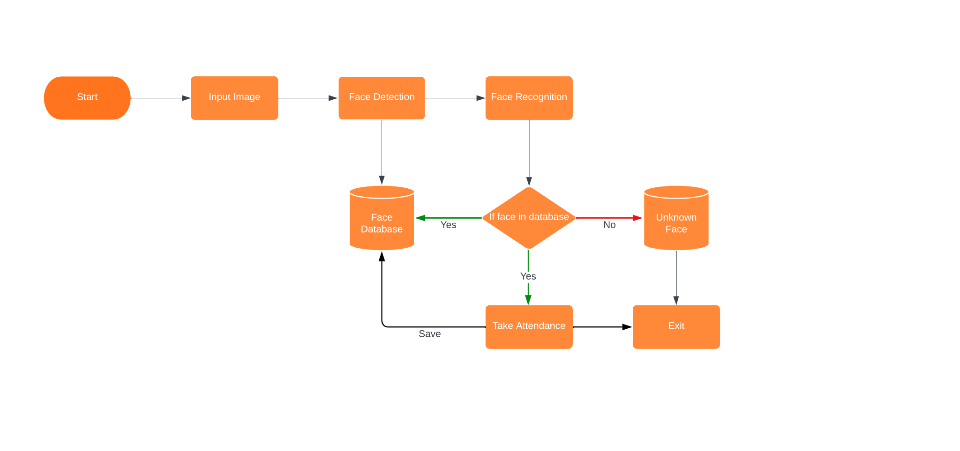
System Design of the proposed system

Slide 9
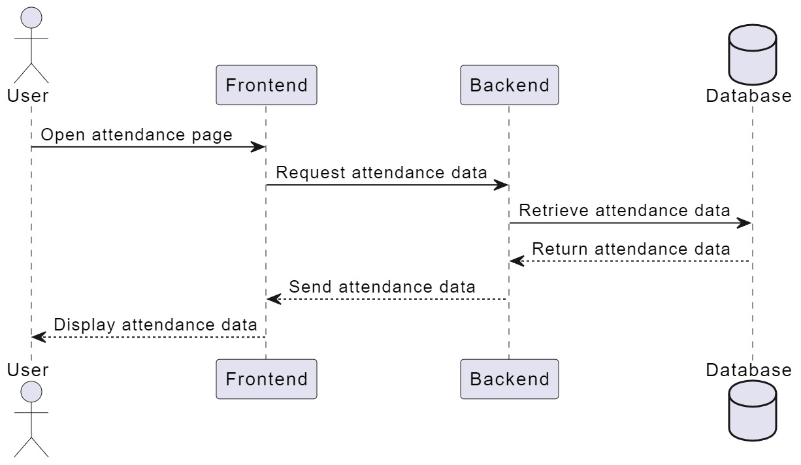
Use Case Diagram
Sequence Diagram
r Rates

Slide 10
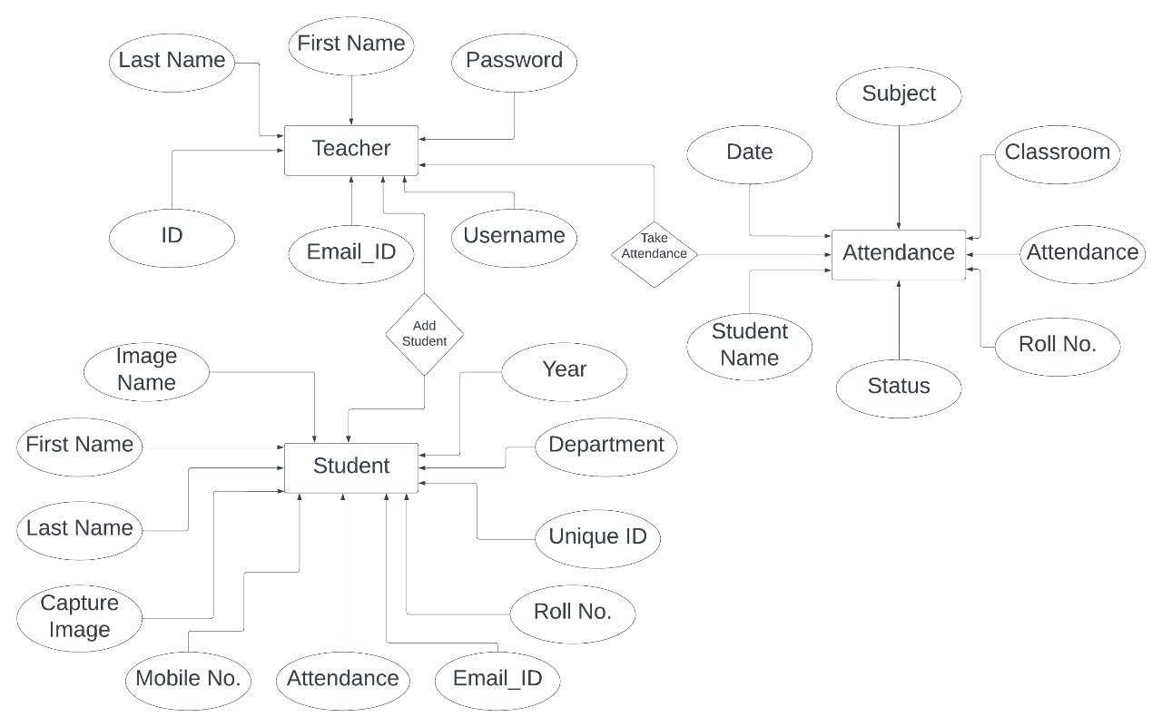
Entity Relationship Diagram
r Rates

Slide 11
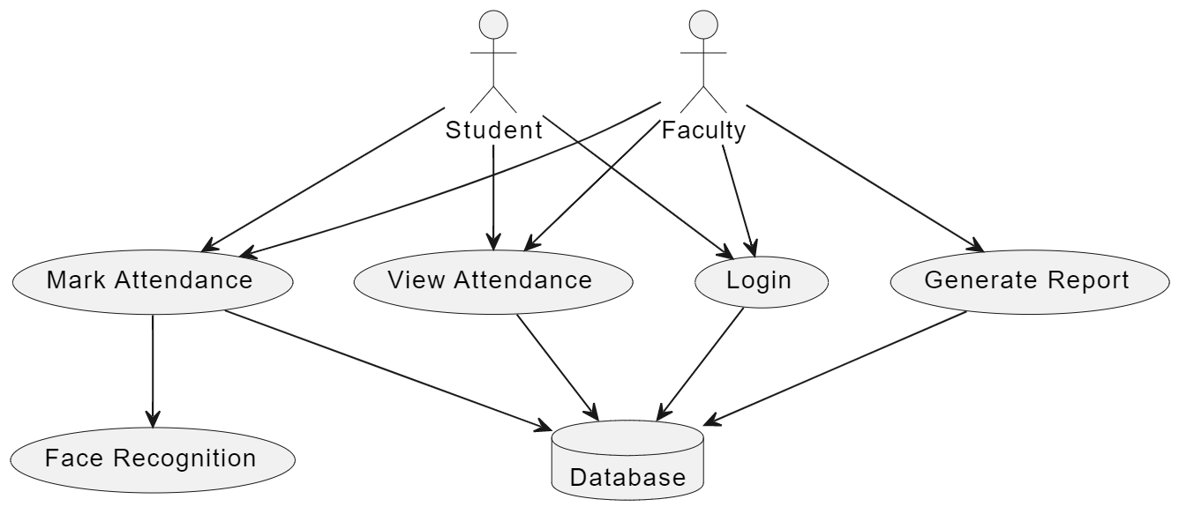
Use Case Diagram
r Rates

Slide 12
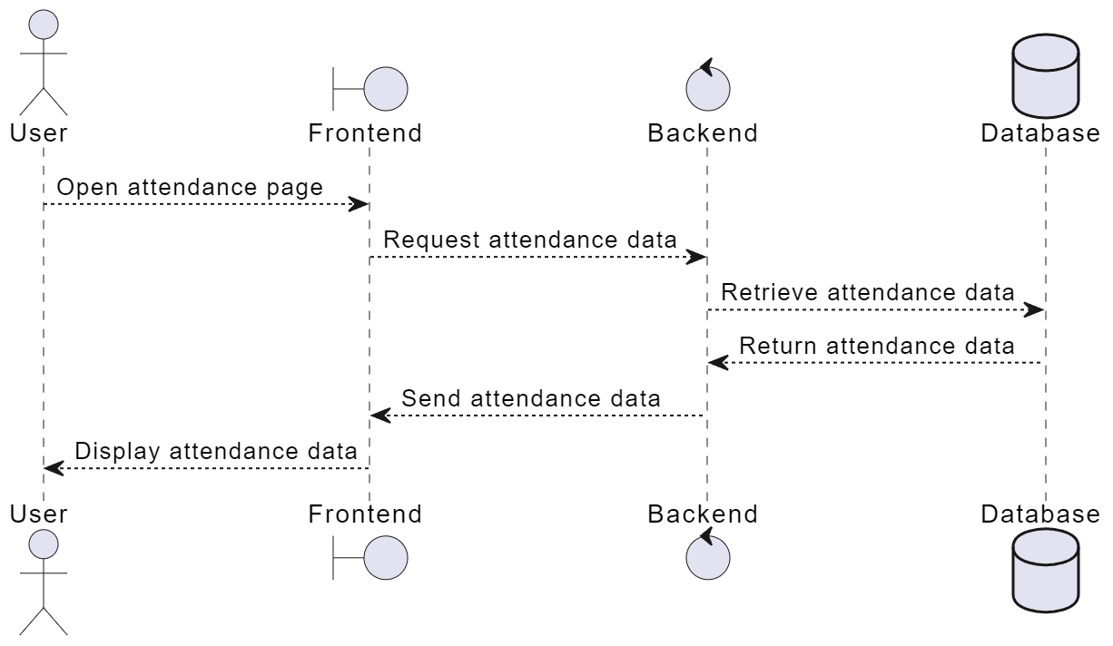
Data Flow Diagram
r Rates

